Slide 1
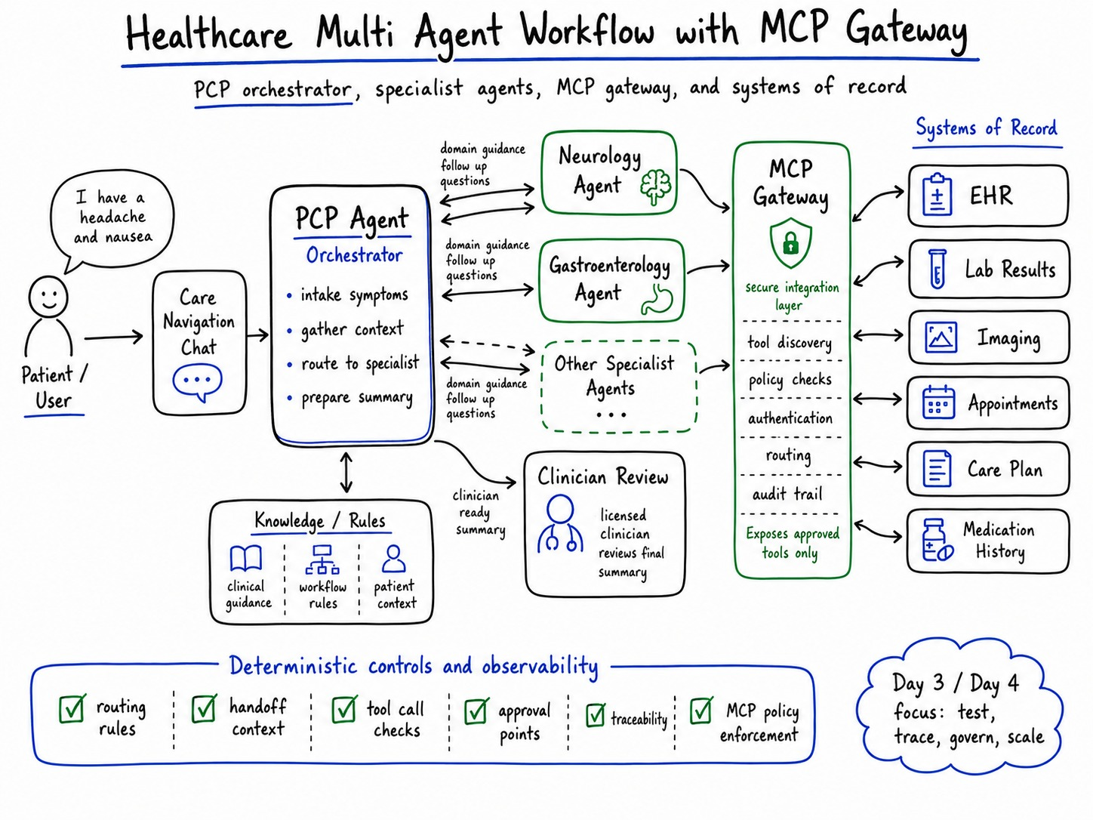
HEALTHCARE AI | OCT 14, 2026
When Physicians Cannot
Connect the Dots
Building a Governed Healthcare Agent with IBM Bob
A technical case study on multi-agent orchestration, clinical workflow boundaries, MCP integration, and human oversight.
Monika Aggarwal
IBM | Enterprise AI and Healthcare Technology
The patient should not have to become the integration layer.
Notes:
Open personally. Earlier this year I was sick and moved through multiple specialists. Each encounter made sense on its own. The burden of connecting the whole story still fell back on me.,That experience gave me a concrete question: if we use agents to coordinate care, what prevents the agent from creating the same fragmentation faster?,This session is about care navigation and workflow design. It is not about replacing physicians.

Slide 2
WHY THIS CASE STUDY
I have lived this problem from both sides
Patient experience shaped the question. Healthcare delivery and enterprise AI shaped how I tested it.
PATIENT
HEALTHCARE BUILDER
ENTERPRISE AI
Multiple specialists. Different slices of the story. The patient still carries context across encounters.
At KP, built clinical workflow and remote monitoring programs spanning 21 hospitals, 250 clinicians, and about 3,000 patients per month.
At IBM, builds governed agentic AI patterns, reusable architectures, and production-focused use cases.
The friction became the design problem.
Reported outcomes: 35% fewer ER visits, 10% fewer hospitalizations, 200% clinician efficiency improvement.
IBM Bob, MCP, agent orchestration, testing, governance, observability.
The design question was simple: can an agent connect context without becoming an autonomous clinician?
Notes:
Keep this under one minute. It is credibility, not biography.,I have spent years on healthcare workflow and remote patient monitoring, and I now work on enterprise agentic AI. That combination matters because this problem lives at the intersection of process, data, integration, and human decision rights.

Slide 3
THE EXPERIMENT
The question I wanted to test
What happens when the agent has too much autonomy and the workflow has too little structure?
LOOSE AUTONOMY
GOVERNED WORKFLOW
“Let the orchestrator decide.”
“Reason inside a designed path.”
Route when it thinks it should
Pass whatever context it chooses
Call tools when useful
Rely on a disclaimer for safety
Gather required intake first
Route against explicit rules
Carry a defined handoff contract
Require review before high-impact action
The interesting part was not whether the model could answer. It was whether the workflow could behave correctly.
Notes:
This is the core setup. Most demos ask whether an agent can complete a task. I wanted to ask a different question: can we prove the path was appropriate?,So I intentionally tested a version where the PCP agent had too much freedom and not enough workflow structure.

Slide 4
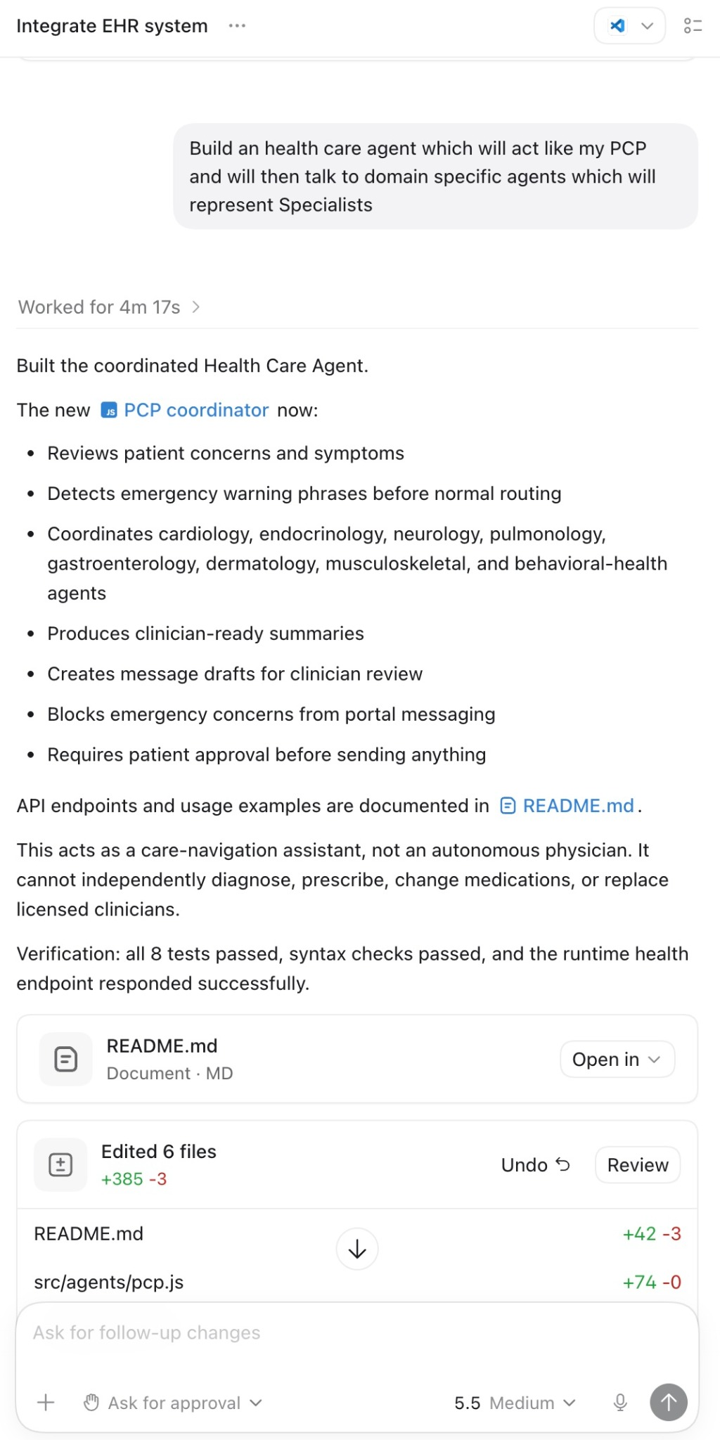
PROTOTYPE
What I built with IBM Bob
IBM Bob accelerated the software build. The healthcare agents are the application, not Bob itself.
PCP orchestrator
Intake symptoms and patient concerns
Detect emergency warning phrases before normal routing
Coordinate bounded specialist support agents
Prepare a clinician-ready summary
Require patient approval before sending messages
Boundary
Care-navigation assistant. No autonomous diagnosis, prescribing, medication changes, or replacement of licensed clinicians.
IBM Bob is an AI SDLC partner for planning, coding, testing, and working with real codebases. Source: IBM Bob documentation, 2026.
Notes:
Important distinction: I used IBM Bob as the development partner to build and iterate on the application. Bob is not the clinical runtime orchestrator.,The application itself has a PCP coordinator and specialist support agents. The PCP agent gathers context, routes, and prepares a summary. High-impact care decisions stay with clinicians.,Bob helped compress the build and test loop, which made it useful for deliberately breaking and hardening the workflow.

Slide 5
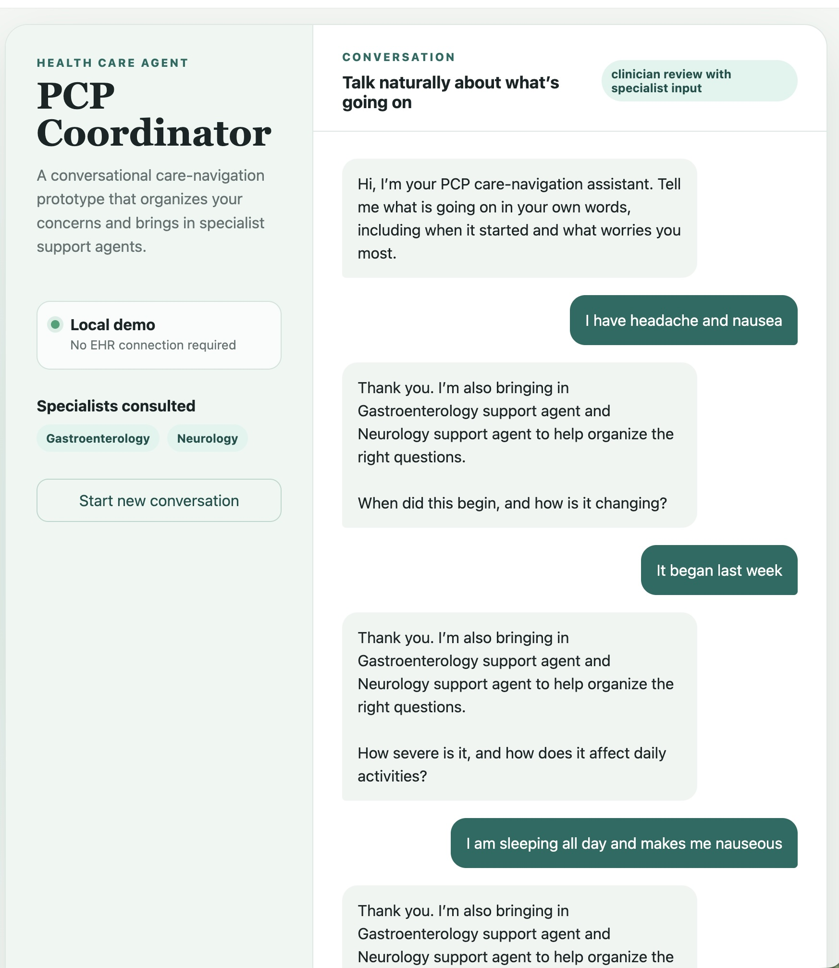
FAILURE TEST
The demo worked. That was the problem.
A plausible conversation can hide a weak workflow.
TEST INPUT
“I have a headache and feel nauseous.”
WHAT HAPPENED
The PCP agent repeatedly brought in Gastroenterology and Neurology before it had enough context to justify the routing.
The safety disclaimer was correct. The workflow behavior was wrong.
Notes:
This is the moment to slow down.,The agent sounded responsible. It asked reasonable questions. It also repeatedly announced two specialist agents before the intake was complete.,That is exactly the kind of failure that slips through a demo because the text sounds sensible.

Slide 6
WHAT FAILED
Activity is not correctness
The orchestrator looked coordinated. The trajectory did not prove understanding.
01
ROUTING
02
HANDOFF
03
NEXT STEP
Specialists were involved before required context was gathered.
The workflow did not prove what context moved to each specialist agent.
The path from intake to follow-up to summary was not deterministic.
What should have happened first
Routing is a decision. A handoff is a contract. Both need evidence.
1
2
3
4
5
6
Onset
Severity
Change
Warning signs
Context complete?
Then route
Notes:
I use this slide to separate three failure types. Routing, handoff, and next-step drift are different problems.,The important point is that observability after the fact is not enough. The design needs an expected path so the trace can be compared against something.

Slide 7
GOVERNED DESIGN
The architecture changed after the failure
The agent still reasons. The workflow decides where reasoning is allowed.
Reasoning lives inside boundaries: routing rules, handoff context, tool checks, approval points, and traceability.
Notes:
Walk left to right. Patient input enters through a care-navigation interface. The PCP agent gathers context and coordinates bounded specialist support agents.,The MCP gateway is the integration layer to systems of record. Clinician review remains explicit.,The most important part is the bottom row: deterministic controls and observability. That is what turns the diagram from agent spaghetti into an operating model.

Slide 8
CONTEXT CONTRACT
The handoff is the product
A specialist handoff should be inspectable, testable, and reconstructable.
HANDOFF CONTRACT
PCP ORCHESTRATOR
SPECIALIST AGENT
1
Symptoms + patient concern
gathers context
checks required fields
decides whether routing is allowed
answers a bounded question
returns domain guidance
does not take over the workflow
2
Timeline + severity
3
Relevant history + meds
4
Red flags checked
5
Reason for specialist input
If you cannot explain what crossed the boundary, you do not have a governed handoff.
Notes:
This is the slide I would want an architecture team to photograph.,A handoff is not just “call Neurology.” It is a contract. What question are we asking, what evidence are we passing, what checks already happened, and why is the route justified?,Once that contract exists, you can test it.

Slide 9
INTEGRATION AND CONTROL
MCP gives the agent a contract for tools
The protocol exposes capabilities. Enterprise policy, authorization, and audit still need an enforcement layer.
01
02
03
04
DISCOVER
AUTHORIZE
EXECUTE
OBSERVE
What tools and resources exist?
Who may call what, under which scope?
Validate tool, parameters, and response.
Record calls, failures, latency, and outcomes.
MCP is not a governance system by itself. The gateway is where policy can become runtime behavior.
Why this matters in healthcare: agents should see only approved capabilities, and high-impact actions should still cross explicit approval points.
MCP 2026-07-28 adds stateless operation and authorization hardening. Enterprise controls around MCP remain an architecture responsibility.
Notes:
I am deliberately precise here. MCP gives us a standard contract for tool and resource access. It does not magically provide enterprise governance.,In my architecture, a gateway around MCP is where we enforce identity, policy, routing, and logging.,The current 2026 MCP specification also hardens authorization and makes gateway-based routing more practical.

Slide 10
DAY 3 AND DAY 4
Testing has to shape the design
Test the trajectory, not only the final answer.
1
2
3
4
5
6
INTAKE
ROUTE
HANDOFF
TOOL
APPROVAL
OUTCOME
Required fields
onset, severity, change, warning signs
Routing rule
specialist only after required context
Handoff trace
what moved, why, and to whom
Tool validation
tool, fields, permissions, response
Decision right
human review for high-impact action
Regression
rerun after prompt, model, tool, policy, or agent changes
A trace is useful only when you know what should have happened.
Notes:
This is the operational core of the talk.,Testing should not be a QA phase after the agents are built. The expected workflow should define what we instrument and what we assert from day one.,Every change can create regression risk. Prompt, model, tool, policy, or agent changes can alter routing and behavior.

Slide 11
DECISION RIGHTS
Human review is a workflow state
Do not sprinkle “human in the loop” on top. Define exactly where authority changes hands.
Gather context, summarize records, draft questions, prepare a message
Low impact, reversible
AGENT CAN DO
Ambiguous routing, missing required context, out-of-scope tool request
Uncertain or policy-sensitive
AGENT MUST ASK
Diagnosis, treatment, medication change, high-impact clinical action
Clinical accountability
CLINICIAN DECIDES
Good governance is not less autonomy everywhere. It is the right autonomy at the right step.
Notes:
A useful design question is not “human in the loop or not?” It is “who owns the decision at this step?”,For this prototype, the agent can organize and prepare. It should ask when context or policy is uncertain. A licensed clinician owns clinical decisions.

Slide 12
FROM PROTOTYPE TO PRODUCTION
The real work starts after the demo
Day 1 proves possibility. Day 3 and Day 4 build operational trust.
1
2
DEMO WORKS
3
Agents answer. Tools connect.
WORKFLOW IS TESTABLE
4
Expected paths and checkpoints are defined.
WORKFLOW IS GOVERNABLE
Access, approval, traceability, and boundaries are explicit.
WORKFLOW IMPROVES
Monitoring and regression testing run after every change.
Production readiness means we can prove the workflow behaved safely, not merely that the model produced a plausible response.
Notes:
This is the executive translation.,The development bottleneck moves quickly. Once agents can generate and connect things, the harder work becomes review, validation, governance, and operating discipline.,That is also why IBM Bob is relevant here. AI can accelerate the build, but the system still needs testable architecture.

Slide 13
CLOSE
One takeaway
A healthcare agent becomes useful when it connects fragmented patient information into a longitudinal view, identifies what needs attention, and supports the right next action with clear human oversight.
DESIGN
GOVERN
TEST
Start with the care process and expected outcome.
Define boundaries, routing, handoffs, tool access, and decision rights.
Validate the full trajectory after every meaningful change.
Thank you
Q&A
Monika Aggarwal | Agent Sense | IBM
Notes:
Close on the accepted takeaway.,If there is time, invite questions around three areas: what failed in the first prototype, which control points should be deterministic, and what would need to change before a system like this entered a real clinical environment.,Seeded moderator questions: How did your patient experience shape the design? Why did the first version fail? Which workflow steps should be deterministic? What changes before real clinical use?

Slide 14
APPENDIX
Selected sources
Public references used to verify product and protocol framing.
Applied AI Summit 2026
Official schedule, Healthcare AI track, October 13 to 15, 2026
https://appliedaisummit.org/schedule/
IBM Bob
AI SDLC partner for planning, coding, testing, and working with real codebases
https://bob.ibm.com/docs/ide
IBM Bob multi-agent updates
Enterprise multi-agent capabilities and specialized workflows, July 2026
https://newsroom.ibm.com/2026-07-09-ibm-advances-enterprise-ai-software-development-with-multi-agent-capabilities-and-specialized-modernization-workflows
Model Context Protocol
2026-07-28 specification release and authorization hardening
https://blog.modelcontextprotocol.io/posts/2026-07-28/
Speaker evidence used in this deck comes from the presenter’s own prior healthcare delivery work and the prototype demonstrated in this session.
Notes:
Backup slide. Do not present unless asked about sources or product framing.

